Slide 1
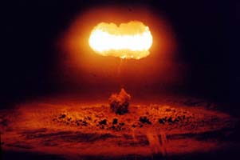
Nuclear Weapons and Nuclear Proliferation

Slide 2
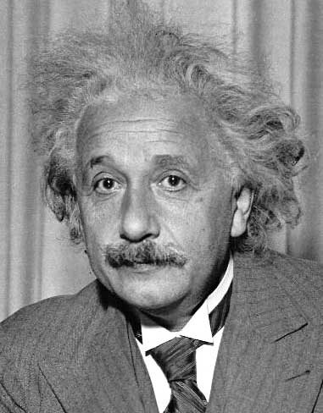
“The unleashed power of the atom has changed everything save our modes of thinking and we thus drift towards unparalleled catastrophe.”
--Albert Einstein
Notes:
Easy to find this quote with Google.

Slide 4
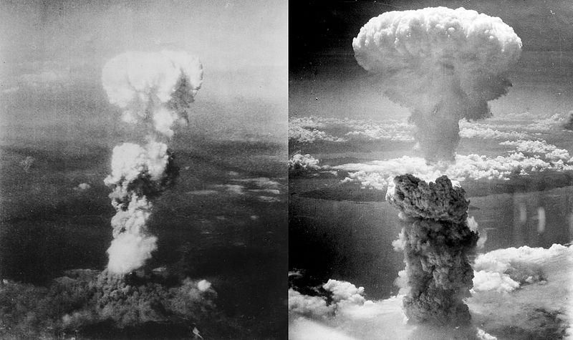
Use of nuclear weapons
1945: USA drops 2 atomic bombs
Killed about 250,000 civilians
USSR (Russia) saw what the United States had, and wanted it too
For the next 40 years, US and USSR competed to see who could have the most nuclear weapons (Cold War)
Notes:
Notes below from an earlier version of the slide, focused less on physicians, perhaps more suitable for a general audience. Current version based mostly on the reference on the slide (and my own experience 1980 and beyond). I co-taught Pediatrics 170.03, “The Health Professional and Nuclear War” at UCSF 1985-89, the last time I was as scared as I am now.
---------
First Einstein letter to Roosevelt 8/2/39 (actually probably written by Leo Szillard) told FDR of the possibility of a nuclear chain reaction that could lead to a bomb that would release vast amounts of energy, and that Germany had stopped the sale of uranium of from Czechoslovakian mines. “That she should have taken such early action might perhaps be understood on the ground that the son of the German Under-Secretary of State, von Weizsäcker, is attached to the Kaiser-Wilhelm-Institut in Berlin where some of the American work on uranium is now being repeated.”
Hiroshima 8/6/45 ~13kT gun-type Uranium bomb “Little Boy”; Nagasaki 8/9/45 ~22kT Plutonium implosion bomb “Fat man.” In his book The Criminality of Nuclear Deterrence (Atlanta: Clarity Press 2002), Francis A Boyle provides a nice history of the decision to use these bombs and their timing, and reasons why not just the use, but the threat of use of nuclear weapons violates international law.
Limited test ban treaty was never signed by France (who continued testing until 1974 and China, who tested until 1980. See: Limited Test Ban Treaty Turns 40 by Daryl Kimball and Wade Boese (2003) accessed 7/5/07 at http://www.armscontrol.org/act/2003_10/LTBT.asp
RE: NPT “The Treaty was opened for signature on 01 July 1968, and signed on that date by the United States, the United Kingdom, the Soviet Union, and 59 other countries. The Treaty entered into force with the deposit of US ratification on 05 March 1970. China acceeded to the NPT on 09 March 1992, and France acceded on 03 August 1992. In 1996, Belarus joined Ukraine and Kazakhstan in removing and transferring to the Russian Federation the last of the remaining former Soviet nuclear weapons located within their territories, and each of these nations has become a State Party to the NPT, as a non-nuclear-weapon state. In June 1997 Brazil became a State Party to the NPT.
The NPT is the most widely accepted arms control agreement. As of early 2000 a total of 187 states were Parties to the NPT. Cuba, Israel, India, and Pakistan were the only states that were not members of the NPT.” From FAS website.
Soviet Union collapsed Dec 1991.

Slide 5
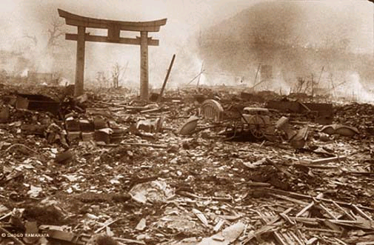
Notes:
[Slide from PSR, with their text, edited)
To date, the use of nuclear and related weapons has been the sole purview of nation-states. A nuclear weapon was first used in warfare on August 6, 1945, at 8:15 a.m., when the U.S. military exploded a nuclear weapon over Hiroshima. The Hiroshima bomb had an explosive force equivalent to 15,000 tons of TNT. The second and last use to date was three days later when the US exploded a bomb equivalent to 21,000 tons of TNT over Nagasaki.

Slide 6
20 kiloton bomb effects: Thermal effects
Creates a giant firestorm with hurricane-force winds and average air temperatures above boiling.
Third degree burns covering 50% of body 1.2 miles away
Notes:
Fat Man and Little Boy—20-ish kt
Modern bombs—25000 kt or bigger
Source on the slide is for the effects.
Picture: http://www.csi.ad.jp/ABOMB/RETAIN/burns1.html: A boy was exposed to thermal rays about 1.5 miles from the hypocenter. February 1946. Photo: the U.S. Army.

Slide 7
Radiation Effects
Notes:
I think the picture is from PSR; I found a b&w version at www.hiroshima-spirit.jp/ en/museum/morgue_w17.html. I’m sure I could find the color version if I looked harder. Photo with caption on Page 237 of Last Aid: 21 year old man 1 km from hypocenter in Hiroshima 8/6/45. Photo taken 2 hr before his death on 9/3/45.
Lethal doses
Radiation units:
1 Sievert= 100 rem = 1 Joule/kg = measures biologic effect of a certain amount of absorbed radation
1 Gray = 100 Rad = measures absorbed radation

Slide 8
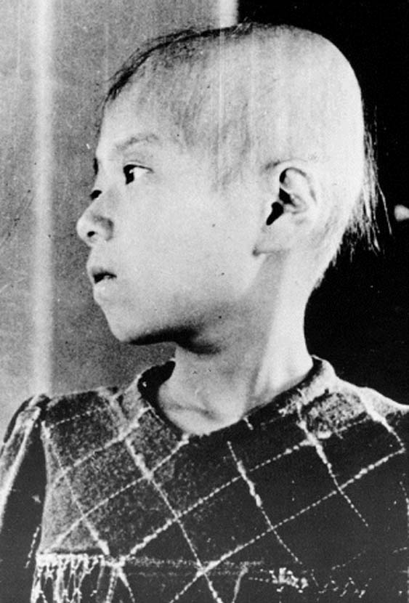
Effects of radiation
“Fall out” -- radioactive dust from the blast crater goes into the mushroom cloud and lands downwind
Chronic Effects: Leukemia, thyroid, and other cancers, pulmonary fibrosis, birth defects/microcephaly, psychological effects
Notes:
Picture also from PSR? Easy to find searching Google images for “Hiroshima radiation.”
REM Effects
0-20 Potential for genetic consequences
20-100 Temporary decrease in white blood cell count.
100-200 Acute radiation sickness - nausea, vomiting, longer-term decrease in white blood cells.
200-300 Vomiting, diarrhea, loss of appetite, death in some cases.
300-600 Vomiting, diarrhea, hemorrhaging, deaths occurring in 50% of cases at 350+ REM
Above 600 Eventual death in almost all cases REM = Roentgen Equivalent Man (1 REM=.01 Sievert)

Slide 9
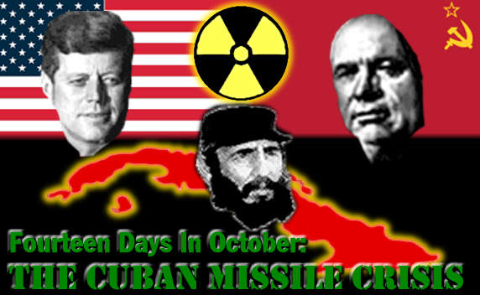
Countries start to limit use
1962: Cuban Missile Crisis—Closest the U.S. ever came to nuclear war.
1963: Limited test-ban treaty bans atmospheric and underwater tests
1970: Nuclear nonproliferation treaty ratified by many countries

Slide 10
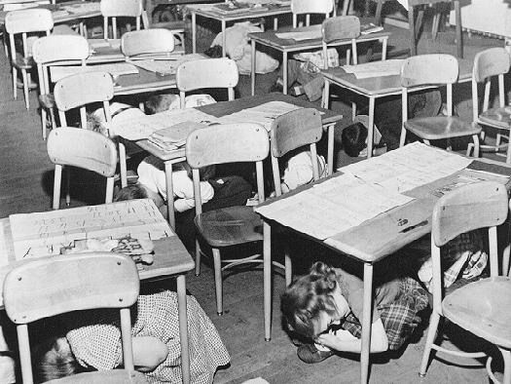
Campaign ad, 1964
https://www.youtube.com/watch?v=riDypP1KfOU

Slide 11
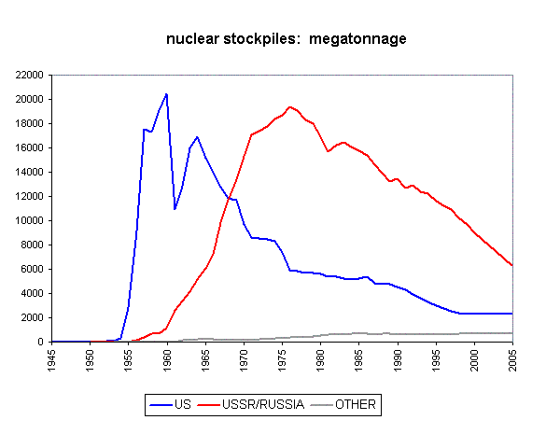
Existing weapons
Notes:
http://www.johnstonsarchive.net/nuclear/nwhmt.gif Accessed 2/5/05

Slide 12
Countries with Nuclear Weapons
Countries with nukes
USA
Russia
United Kingdom
France
China
Israel
India
Pakistan
Programs ended after 1970
Argentina
Brazil
Romania
South Africa
Spain
South Korea
Switzerland
Taiwan
Yugoslavia
Libya
Programs ended by 1970
Sweden
Canada
Australia
Egypt

Slide 13
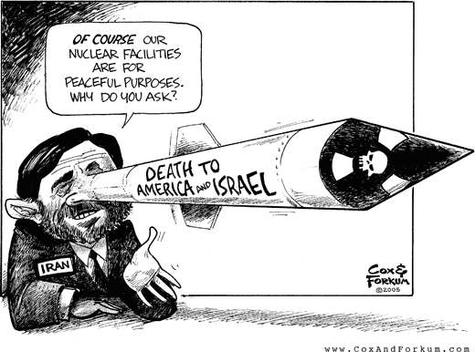
Iran’s Nuclear Program
We only want nuclear power!
BUT: developed nuclear program in secret
Relationship with Israel and terrorist organizations
Iran’s Nuclear Program: Congressional Research Service Report for Congress, 9/6/2006
Notes:
http://www.fas.org/sgp/crs/nuke/RS21592.pdf

Slide 14
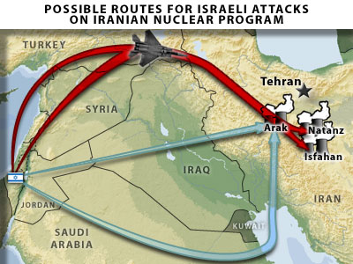
Are we being fair?
Strict enforcement for Iran
Nuclear weapons OK for friends, even in violation of NPT
India and Israel have not signed the NPT

Slide 15
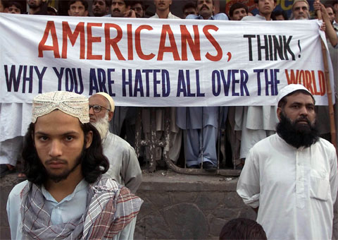
Americans, think
Notes:
Slide from PSR
AP Photo by B K Bangash
******
Photo source: <www.savannahnow.com/images/ 091601/full_hated.jpg>

Slide 16
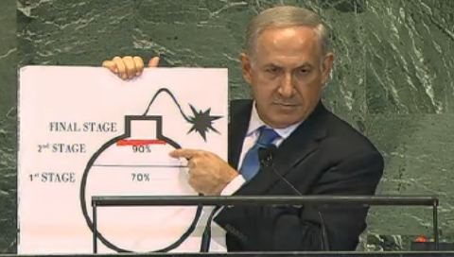

Slide 17
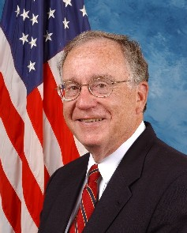
“We have more nuclear weapons now than we know what to do with…I’m concerned about our image in the world when we’re telling others not to build these things, and then we push these new weapons.”
Representative David Hobson (R-Ohio)
Notes:
Slide from PSR
This is Rep Hobson who was a real hero, cutting all funding for new nuclear weapons in FY 2005.
********************
Photo source: <www.house.gov/hobson/ >

Slide 18
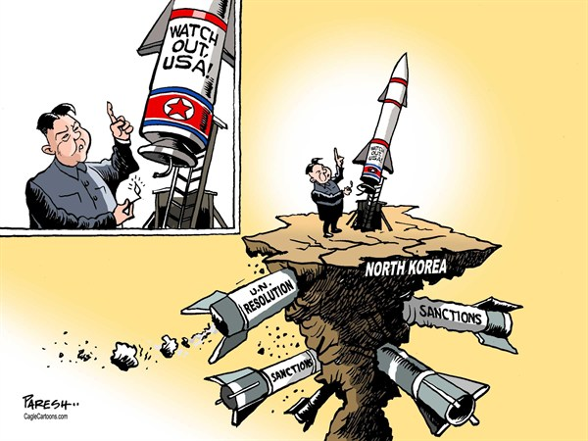

Slide 19
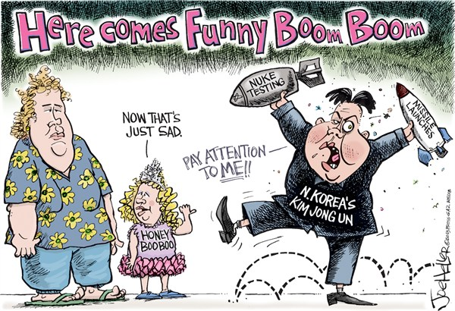

Slide 20
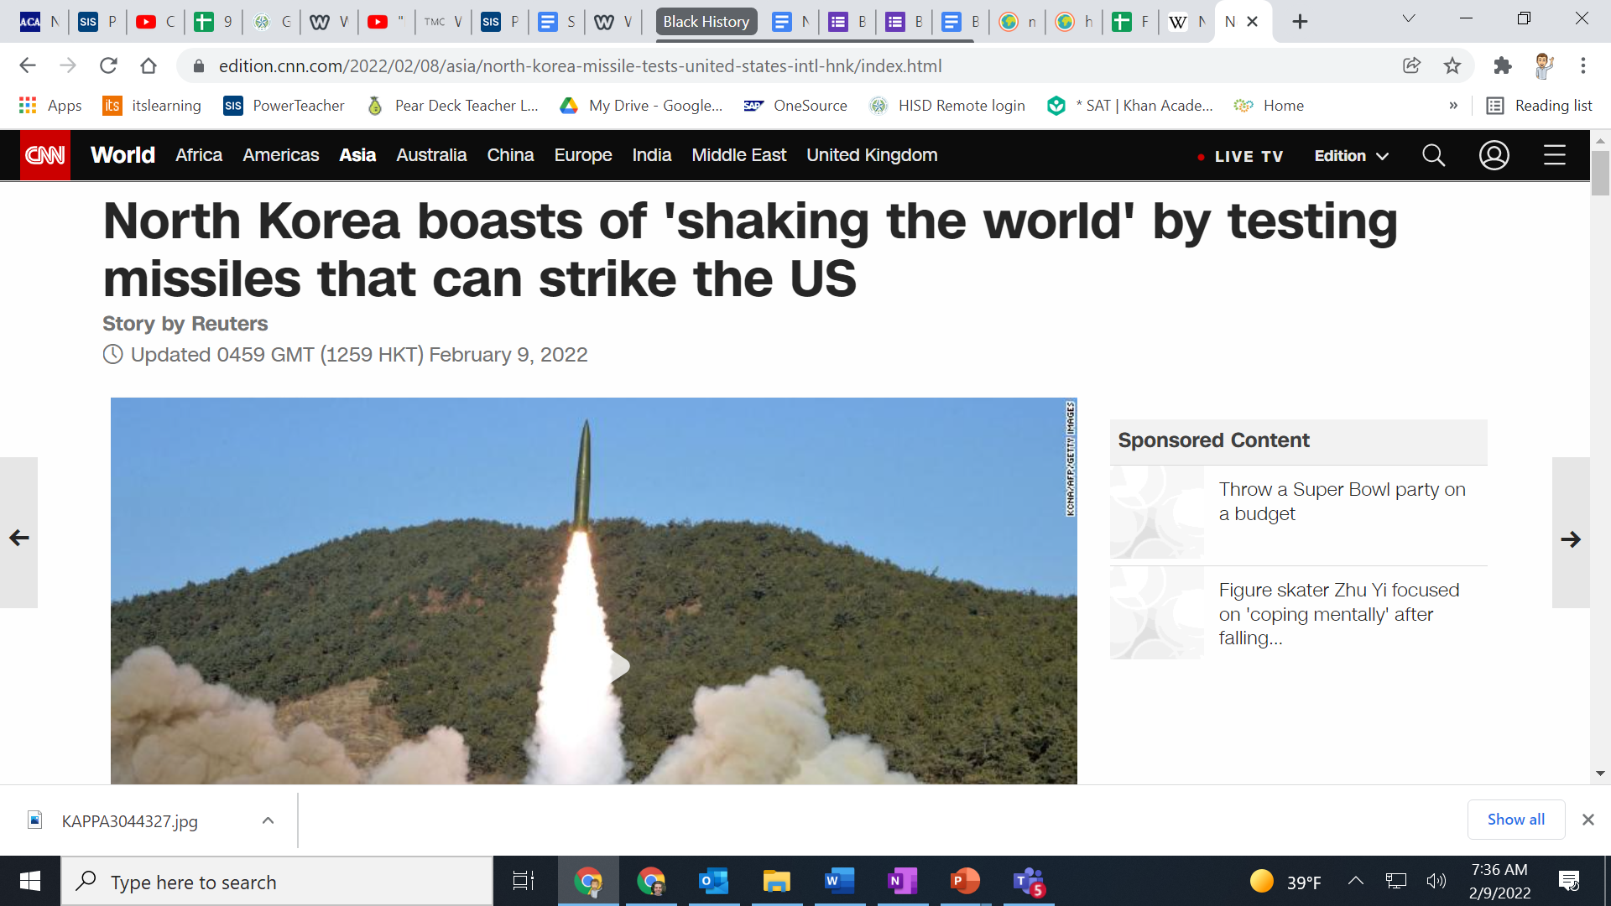

Slide 21
Safeguarding Fissile Materials
Do we know where all of our nuclear materials are?
Notes:
See Allison, Nuclear Terrorism, p.65. Yuri Smirnov stole 50 g HEU at a time from the Luch Scientific Production plant. He was caught on the way to Moscow to sell it when he happened upon one of his neighbors sharing vodka with friends and the whole group was arrested for stealing batteries from the plant where they worked. Yuri told the story on the PBS program ‘Frontline,” easily found on the web.

Slide 22
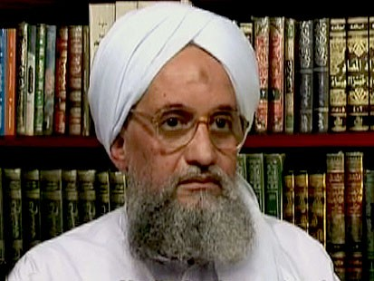
Nuclear Terrorism
“Dirty bomb,” attack on nuclear power plant by terrorist groups is a possibility

Slide 23
Nuclear Energy
https://www.youtube.com/watch?v=Q0PIrRCJP8w
Chernobyl
Less than 100 immediate deaths
Thousands of eventual deaths
300% increase in cancer rates
Fukushima—
7 cases of lukemia, 39 radiation burns
Predicted 1% increase in cancer rates

Slide 24
10% of global energy usage!!!
Who is using nuclear energy as a stepping stone?
Notes:
10% of total global energy (2022)

Slide 25
Countries

Slide 26
Countries—6th Period
USA—Emilee
China--Yanin
Russia--David
France--Osman
UK--Austin
India--Daisy
Pakistan--Sergio
North Korea--Melissa
Iran--Carlos
Israel--Gerson
South Africa
Sweden--Stephanie
Colombia--Kati
Mexico--Marlen
Canada--Jazmin
Australia--Joel
Spain--Dayra
South Korea--Tracy
Argentina --Kevin
Brazil--Olvin
Ukrane--Lamarco
Norway--Camila
Costa Rica--
Congo--Catesha
Sudan--Jimmy
Somalia--Karina

Slide 27
Countries—7th Period
USA—Estefania
China--Jennifer
Russia--Joel
France--Juan
UK--Sephora
India--Kenia
Pakistan--Alexis
North Korea--Steven
Iran—Erika
Israel--Bianca
South Africa
Sweden—Kevin
Colombia—Bianca R.
Mexico--Brayan
Canada--Emily
Australia--Charlene
Spain--Daniel
South Korea--Calixto
Argentina --Zach
Brazil--Marco
Ukrane--
Norway--Linette
Costa Rica—Van
Congo--
Sudan--Virginia
Somalia—
Japan—Luis
Cuba—Jairo
Germany--Michael

Slide 28
Countries—5th Period
USA—Dulce
China--Jesus
Russia—Jesus
France--Mario
UK—Erik
India—Janeth
Pakistan--Rachel
North Korea--Javier
Iran—Hector
Israel--Elyssa
South Africa—Mater
Sweden--Diana
Colombia—Precious
Mexico—Thelma
Japan--Arturo
Canada—Barbara
Australia—Rosa
Spain—Junior
South Korea--Jaime
Argentina --Genaro
Brazil—Gisselle
Ukrane—Raul
Norway—Abby O
Costa Rica--Josh
Congo--Aided
Sudan--Brenda
Somalia—Shelby
Cuba--Fidel
El Salvador—Igmar
Honduras--Brany

